Slide 1
PROG6212 POE PART3 Tapiwa Sango ST10276025

Slide 2
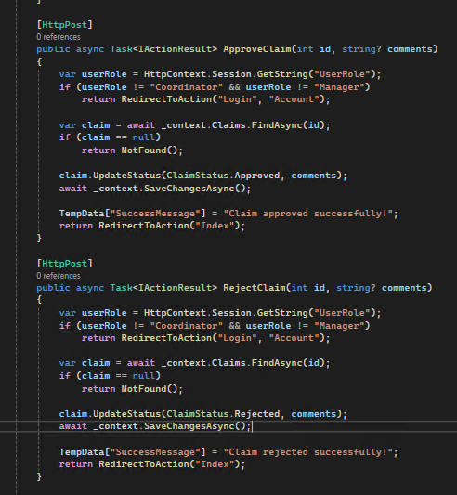
Lecturer Feedback
“Fix the approval flows, a claim should be approved by both coordinator and manager, if coordinator approves, manager can approve/reject then the claim can changes status on the lecturer view”
Both Manager and Coordinator are able to approve and reject claims. To the left is the shows the ApproveClaim() and RejectClaim() which:
Ensures user role is valid.
Finds the claim by ID.
Calls UpdateStatus(Approved/Rejected, comments).
Saves changes.
Shows a success message.
Purpose: Allows manager and coordinator to approve and reject the claim.[Note that the RejectClaim()has the same flow the ApproveClaim()]

Slide 3
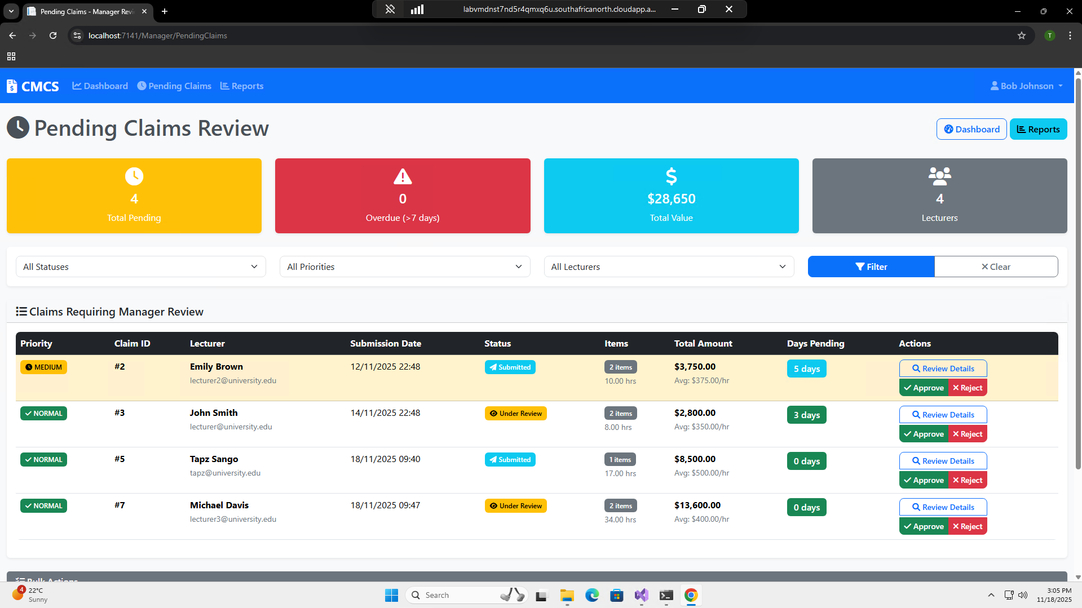
Manager Functionality for Rejecting and approving Claims

Slide 4
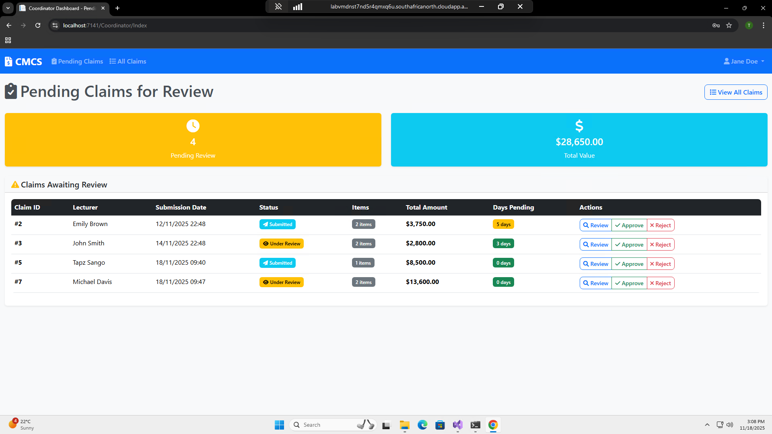
Coordinator Functionality for Rejecting and approving Claims

Slide 5
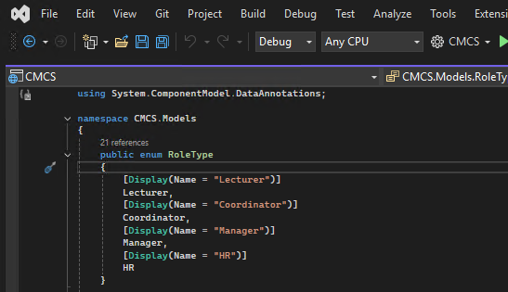
Part 3 Additions
New role added, HR as “super user”.

Slide 6
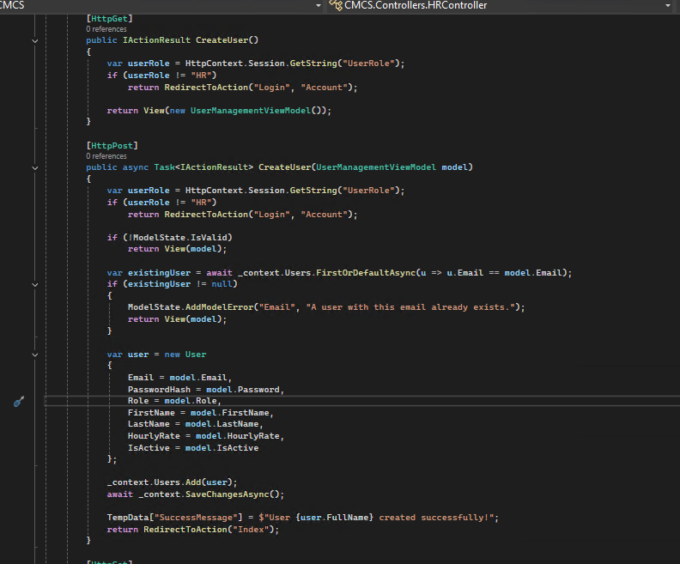
Creation of User VIA HR
CreateUser (GET):
Displays the create-user form.
Only HR can access
Returns an empty UserManagementViewModel
CreateUser (POST):
Handles the creation of a new user.
Validates input
Checks if email already exists
Creates new user with: Name, Email, Password, Hourly rate, Role (Lecturer, HR, Manager, etc.) & Active/Inactive status
Saves to database
Shows success message using TempData

Slide 7
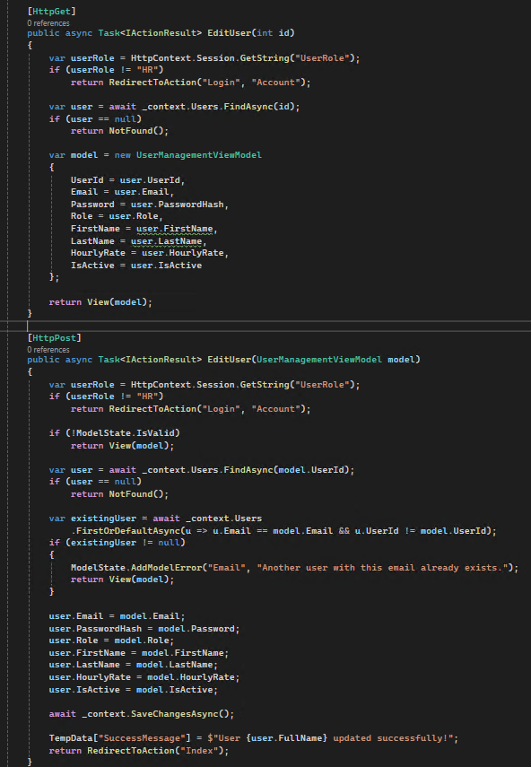
Editing of User VIA HR
EditUser (GET):
Loads an existing user's data for editing.
Finds the user in the database
Maps the data to a ViewModel
Pre-fills the form for HR
EditUser (POST):
Updates a user's profile
Validates the form
Checks email uniqueness (avoids duplicates)
Updates fields: Name, Email, Password, Hourly rate, Role (Lecturer, HR, Manager, etc.) & Active/Inactive status
Saves to database
Shows success message using TempData

Slide 8
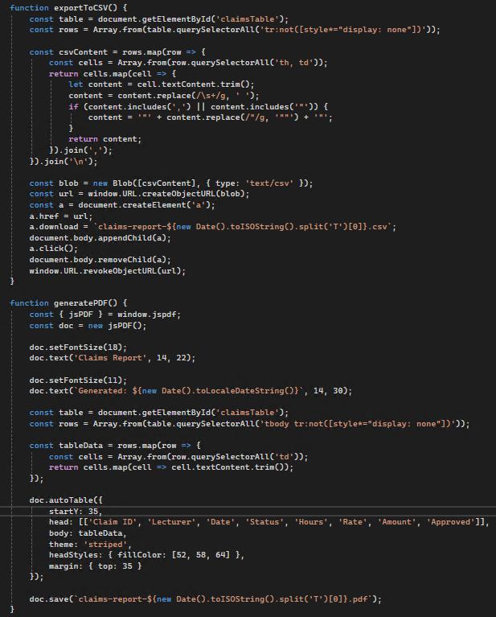
Exporting to CSV & Generating PDF VIA HR
Exporting to CSV
Steps:
Gets visible rows only
Extracts text from each cell
Escapes commas and quotes for CSV safety
Creates a CSV file
Downloads it automatically
Generate PDF
Uses jsPDF + AutoTable:
PDF includes:
Title
Date generated
All visible claim rows
Downloaded automatically with today’s date.

Slide 9
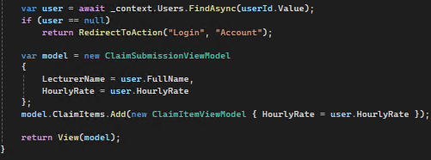
Hourly Rate & Auto calculation function
The hourly rate comes directly from the User(HR) table in the database. Nothing “calculates” it in the controller it reads whatever rate is stored on the logged in user’s record and injects it into the claim.
When the hours are input then the auto calculation shows with pulled hourly rate.

Slide 10
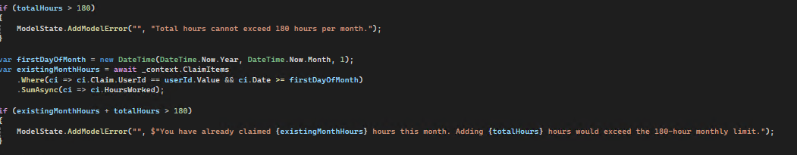
Work Hours Validation
This code prevents a user from claiming more than 180 hours in a month. It first blocks any single submission over 180 hours. Then it calculates the first day of the current month and sums all hours the user has already claimed for that month. If the new hours plus the existing monthly total exceed 180, it adds a validation error telling the user how many hours they've already claimed and why the new claim would push them past the limit.

Slide 11
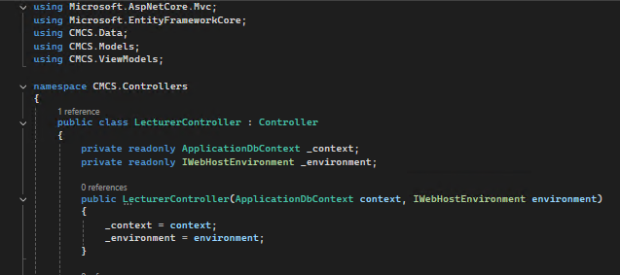
EF with a database
This code incorporates EF and through out the whole code of the app.

Slide 12
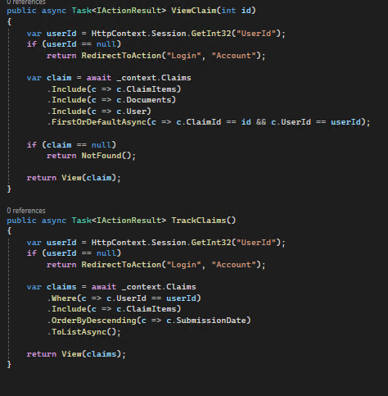
Lecturer can View and track claims
These two actions let a logged-in user view their claims. ViewClaim checks the session for a user, loads one specific claim (matching the claim ID and the logged-in user), includes related items, documents, and user details, and returns it to the view. If the claim doesn’t exist, it returns NotFound. TrackClaims loads all claims that belong to the logged-in user, includes claim items, sorts them by newest first, and displays them. Both actions block access if the user isn’t logged in.

Slide 13
THANK YOU
Tapiwa Sango
ST10276025
PROG6212
POE Part 3

